Slide 1
Rails From Scratch
Day 2 https://goo.gl/xnXuX6 Martyn Whitwell whitwellm@ebi.ac.uk

Slide 2
Contents
Today we hope to cover:
Getting started with Rails
First look at MVC, templates, routes, migrations, best practices
Workshop: depot application
Unit testing with RSpec

Slide 3

Introduction
Ruby on Rails was created by David Heinemeier Hansson (DHH) in 2005. It was intended to provide a framework for the agile development of web applications. It follows a Model-View-Controller paradigm and contains a whole stack of features to assist in the development of web applications.
Rails is a nice framework to work with, provided you do things “the Rails way”:
Don’t repeat yourself
Convention over Configuration

Slide 4
Getting started
NB: we will be working from “Agile Web Development with Rails 5.1” by Ruby, Copeland and Thomas (2017).
Open RubyMine
Create a new Rails Application project named ‘hello_rails’
After a few seconds, you should see some gems being installed and a list of folders and files.
Click on Run (or press Shift+F10) and open a web browser and goto http://localhost:3000/
Hopefully you should see a Your on Rails screen!

Slide 5
Say hello
In RubyMine, select Tools > Run Rails Generator… and select “controller”
In the Add New Controller window, enter:
Controller name: Say (note the CamelCase - this is a class name)
Actions: hello goodbye (note the snake_case - these are method names)
Click on OK
Your new SayController class will load - take a look at app/controllers
Also take a look at config/routes.rb - this file tells Rails how to map an HTTP request to a specific controller
Now point your web browser to http://localhost:3000/say/hello - hopefully you’ll see a ‘Say#hello’ page
Notes:
Note that all the rails generators and tools are also accessible via the command line:
$ rails help
$ rake -T

Slide 6
Rails folder structure
Rails defines a folder structure for us: all of the MVC code (models, views, controllers, plus helpers, mailers, jobs, channels and assets) goes in the app/ folder. E.g.
models will be stored in app/models/
views will be stored in app/views/<controller_name>/
controllers will be stored in app/controllers/
javascripts will be stored in app/assets/javascripts/
Configuration code, such as routes and initializers go in the /config folder
User library code belongs in the lib/ folder. User rake tasks go in the lib/tasks/ folder.
Notes:
The structure may seem a little daunting… but you’ll get used to it!

Slide 7
Introducing templates
In RubyMine, open app/views/say/hello.html.erb
This is an ERB html template. It generates HTML to send to the browser and allows us to inject Rails content and Ruby code into the HTML. Change the template to:
<h1>Hello from Rails!</h1>
<p>It is now <%= Time.now %> </p>
Save and reload http://localhost:3000/say/hello - hopefully it should say “Hello from Rails!” as well as tell you the current time.
Notes:
Note the <%= something %> brackets in the ERB template

Slide 8
Doing things the Rails way
Templates should not contain business logic. They should be focused purely on the presentation of data which has previously been determined by the models, controllers, helpers and libraries.
So let’s move getting the current time (which may be dependent on e.g. the user’s timezone) to the hello method of SayController and change the hello template.
# say_controller.rb
def hello
@time = Time.now
end
# app/views/say/hello.html.erb
<h1>Hello from Rails!</h1>
<p> It is now <%= @time %> </p>

Slide 9
Using routes
Lets add a goodbye template and then link hello and goodbye together
# app/views/say/goodbye.html.erb
<h1>Goodbye!</h1>
<p>It was nice having you here.</p>
<p>Say <%= link_to "Hello", say_hello_path %> again. </p>
# app/views/say/hello.html.erb
<h1>Hello from Rails!</h1>
<p> It is now <%= @time %> </p>
<p> Time to say <%= link_to "Goodbye", say_goodbye_path %>! </p>
Notes:
Nb: we could have used a simple hard-coded link, <a href=”/say/hello”> or <a href=”/say/goodbye”>. But this is bad practice - use helpers to keep your application agile.

Slide 10
Task: display all the files in the current folder
Update the hello method in the SayController to get a list of files in the current folder and store this in a variable: @files = Dir.glob('*')
Update the hello template to print out an html-bulleted list of files, e.g.
file1.rb
file2.txt
file3.bla
Hint: remember enumerations and explore <%= %> vs <% %> in erb templates

Slide 11
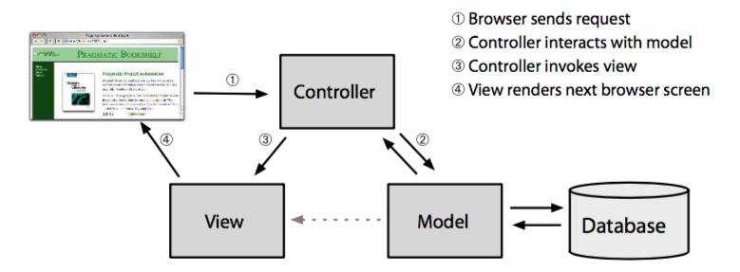
Models, Views and Controllers
From “Agile Web Development with Rails 5.1”, p.40

Slide 12
Models
Models are objects. Models are concerned with the representation of something: that could be a real something (like a manuscript or user) or it could be a more abstract something, like the relationship between a user and a manuscript. Models typically define validations (such as “0 >= age <= 100”) and relationships to other models.
Models should not define business logic, such as “if the user is an admin then send an email” - that is for Controllers.
In Rails, we use an Object-Relational Mapping (ORM) library called Active Record. It handles the complexity of serialising and de-serialising Models to a database.
Notes:
Other ORMs are available to support more exotic data stores; such as Active Fedora (Fedora Commons) and Mogoid (MongoDB).

Slide 13
Views and Controllers
Controllers are responsible for business logic (like creating new objects) and for getting data ready to be presented by the Views.
Views are responsible for presenting data. They should not contain business logic, only presentation logic.
Rails allows for multiple views for the same controller method: e.g. you can create both an HTML template to suit a web browser, a JSON template to suit a machine API and an RDF template to suit a news reader application.
Views and Controllers are defined in a library known as Action Pack.

Slide 14
Database migrations
Rails has a great feature for maintaining the database schema: migrations. You can define a migration such as:
class AddReleaseDelayToPaper < ActiveRecord::Migration
def change
add_column :papers, :release_delay, :integer
end
end
These changes can then be applied or rolled back onto the database with:
$ rake db:migrate $ rake db:rollback
Notes:
All migrations must inherit from ActiveRecord::Migration

Slide 15
Rails best practices
Keep your models thin - their focus is on valid data
Keep your data normalised - avoid storing the same thing in multiple places
Keep your views simple - presentation logic is not business logic
Let your controllers do the heavy lifting
Also, remember the Rails principals: Don’t Repeat Yourself (DRY) and Convention over Configuration
Follow the Rails pattern, develop incrementally and demo often!

Slide 16
Workshop: Depot Application
So far we have talked about some Rails concepts and seen a very simple Rails application. But there is much more to learn about Rails! We will explore Rails in detail by building a shopping cart system, Depot, incrementally adding features as we go.
Let’s start with two use cases:
The buyer uses Depot to browse the products we have to sell, select some to purchase, and supply the information needed to create an order.
The seller uses Depot to maintain a list of products to sell, to determine the orders that are awaiting shipment, and to mark orders as shipped.
Note: before we move on, stop running and close any open projects.

Slide 17
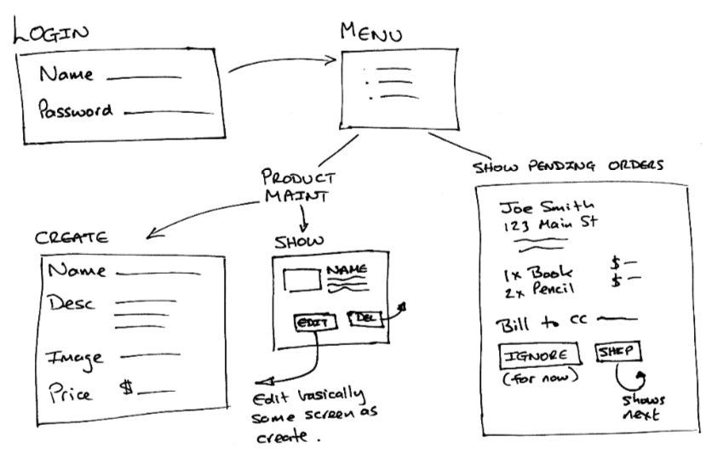
Seller flow

Slide 18
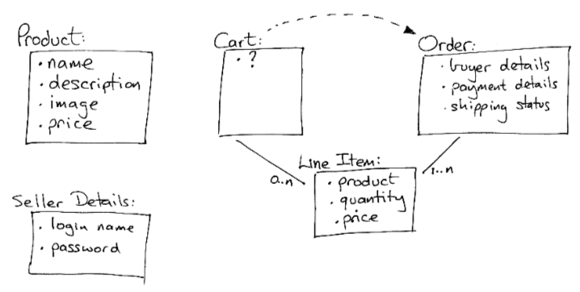
Initial database schema
Notes:
We’ll just focus on the Product table today

Slide 19
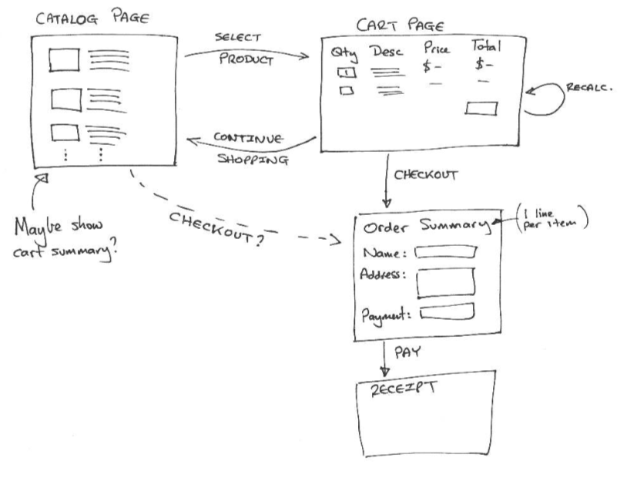
Buyer (shopper) flow

Slide 20
Creating the Depot application
Open RubyMine and create a new Rails Application project named ‘depot’.
We will use SQLite as our initial database; so no software or setup is required. Verify the application runs at http://localhost:3000/
Let’s create some code and data structures for managing products:
In RubyMine, click Tools > Run Rails Generator and select “scaffold”
Enter the following generator arguments (on one line): Product title:string description:text image_url:string price:decimal
Click on OK
Notes:
Note that Product is a model and is a class name, hence given in CamelCase, whereas the fields are in lower snake_case.

Slide 21
Updating the create form
In RubyMine, choose Tools > Run Rake Task and select “db:migrate”. Click on OK.
The database has been updated: a new table has been created with our new fields.
Go to http://localhost:3000/products and see the products index page. Check out the New Product page too. Let’s make the description box a bit larger: Open app/views/products/_form.html.erb and modify the product description text_area to:
<%= form.text_area :description, id: :product_description, rows: 10, cols: 60 %>
Notes:
Note that the |form| variable is part of the block called by form_with()

Slide 22
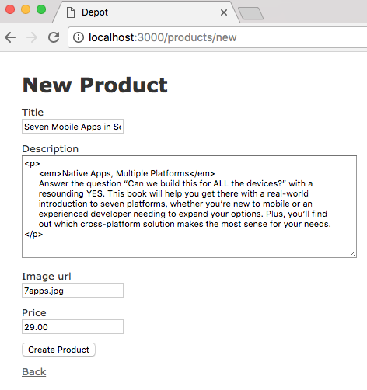
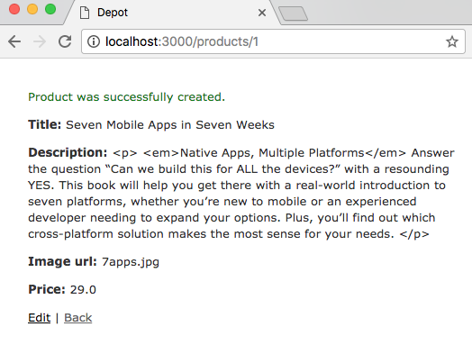
Create a product

Slide 23
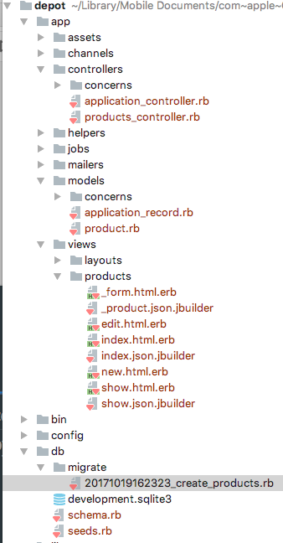
Rails Scaffolding
With one command, scaffolding allows us to generate database structures, controllers, models and views etc.
Before we run it, let’s manually tweak the migration script. Open the xxxx_create_products.rb file in db/migrate. (The filename will start with a timestamp.)
Change:
t.decimal :price
To:
t.decimal :price, precision: 8, scale: 2

Slide 24
Seeding the (development) system
Let’s make our development and testing a little easier by loading some seed data
Copy seeds.rb to the db/ folder (replacing the existing file)
Download and expand the images.zip (or images.tgz) archive and copy all the images to app/assets/images
Load the seeds by running the rake task “db:seed” (in RubyMine, Tools > Run Rake Task)
Check that new products appear in http://localhost:3000/products

Slide 25
Styling the products index page
The index page http://localhost:3000/products could do with some styling.
Download products.scss and copy it to app/assets/stylesheets
Download products/index.html.erb and copy it to app/views/products/index.html.erb
Update app/views/layouts/application.html.erb and change the <body> tag to:
<body>
<main class='<%= controller.controller_name %>'> <%= yield %>
</main>
</body>
Notes:
You may need to re-save the products.scss file in order for its timestamp to be updated.
Note that all the stylesheets and javascripts are loaded at once (and in a production environment, they are usually compressed into a single file) - so we are using the <main> tag in the layout to limit which CSS class is being applied.

Slide 26
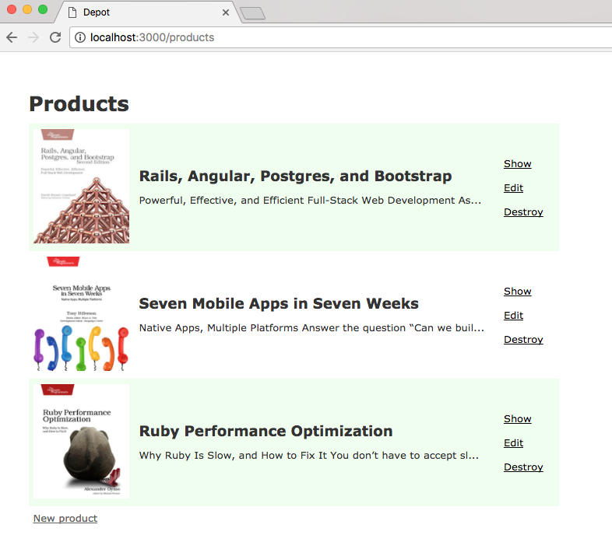
Products index
Notes:
Note the use of cycle(), truncate() and strip_tags() in the index template.

Slide 27
Committing the code
We’ve reached a point where it would be good to commit our work to source control.
RubyMine has initialised an empty git repository for us, so we need to add our files to it. Right-click on the project directory and choose Git > Add. Add all the files.
The goto VCS > Commit… and commit the project with a suitable message.

Slide 28
Validations for presence
Let’s improve the system to ensure that all the fields must be present.
Locate the Product model and add a call to the validates method, thus:
class Product < ApplicationRecord
validates :title, :description, :image_url, presence: true
end
Now try and create a new product with a missing title / description / image...
Notes:
The validates() method is the standard Rails validator. It checks one or more model fields against one or more conditions.
presence: true tells the validator to check that each of the named fields is present and that its contents aren’t empty

Slide 29
Validations for number
Update the Product model with a further validation for price:
validates :price, numericality: {greater_than_or_equal_to: 0.01}
NB: checking that price is >= 0.01 is preferable to > 0, because a price of 0.0001 would pass the validation but would be rounded down and stored in the database as 0.
Test that the number validator is working as expected.

Slide 30
Validations for uniqueness
Lets ensure that all product titles are unique:
validates :title, uniqueness: true
Note that the uniqueness check runs at the application level, rather than at the database level. For more advanced databases (postgres, mysql, oracle etc) we could complement this application level check with a database constraint.
Test that the uniqueness validation is working as expected.

Slide 31
Validations for format
Finally, let’s ensure that the image_url field always points to an image by testing it with a regular expression:
validates :image_url, allow_blank: true, format:
{ with: %r{\.(gif|jpg|png)\Z}i, message: 'must be a URL for GIF, JPG or PNG image.'}
Test that the format validation is working as expected.
Notes:
Is this a block or a hash?

Slide 32
Unit testing of models
So far we have been tweaking our code and then manually testing that it behaves as we expect. This approach has some problems:
What if we change something elsewhere in the system which breaks the functionality we’ve just manually tested? We won’t know about it unless we manually re-test the whole system
Manual testing is slow and hard work, so there is less incentive to do it
A much better approach is automating the testing. Unit tests allow us to automate the testing of individual components of the system, such as models. The unit tests can be run during development - e.g. on every commit.

Slide 33
MiniTest or RSpec?
By default, Rails comes bundled with a testing suite known as ActiveSupport::TestCase which is in turn derived from another test framework called MiniTest.
However, there is an alternative testing framework, RSpec, which is very popular in the Rails world. RSpec tests have their own language (DSL) and are arguably closer to English, making them easier to read by non-programmers.
We shall favour RSpec over MiniTest primarily because that is what Aperta uses :-)
Notes:
DSL: Domain Specific Language

Slide 34
Installing RSpec
First of all, let’s delete the skeleton MiniTest tests Rails automatically created for us: In RubyMine, right-click on the test folder and delete it.
Next, open the Gemfile in the application root
Locate the group :development, :test
Add the RSpec Rails gem to this group:
gem 'rspec-rails'
In RubyMine, click on Tools > Bundler > Install. Then click on Install (no arguments)
Notes:
Nb: open Gemfile, not Gemfile.lock !
Gems are Ruby libraries bringing extra functionality to Rby projects

Slide 35
Installing RSpec continued….
Now that the rspec-rails gem is installed, we need to create some configuration files
In RubyMine, click Tools > Run Rails Generator > rspec:install > OK
A new spec folder will appear in the solution: this is where we store our tests
Generate a skeleton product_spec.rb file with:
Tools > Run Rails Generator > rspec:model > product > OK
In RubyMine, click on Run > ‘Run all specs in depot: depot’
There should be 1 example in a pending status

Slide 36
General format of RSpec
An RSpec file generally describes an individual Ruby class. It typically consists of one or more context blocks. Each context sets up a particular situation for a use-case of the class. Within each context are one or more expectation tests which verify a particular aspect of the class and its behaviour.
Describe <some class>
Context 1 <some situation>
Test 1
Test 2 Context 2 <another situation>
Test 3

Slide 37
spec/models/product_spec.rb (1)
RSpec.describe Product, type: :model do
subject(:product) { Product.new(title: 'Product 1',
description: 'A great product',
image_url: 'http://somewhere.com/image.png',
price: 123.45) }
context "valid product" do
it "is valid" do
expect(product.valid?).to be true
end
end
Notes:
Try running the RSpec tests now; there should be one pass

Slide 38
spec/models/product_spec.rb (2)
...
context "negative price" do
before do
product.price = -123.45
end
it "is invalid" do
expect(product.valid?).to be false
end
end
end

Slide 39
General RSpec tips
Speed is of the essence: make your tests as fast as possible. Waiting 10-15 minutes for hundreds of tests to run becomes quite a burden
Avoid saving records if you can as this slows them down. If you do need to save data, use the bang methods: create! save! update! destroy!
Tests should not interact with external systems (such as Solr, websites and APIs). If necessary, use mocks to simulate the conversation between the class being tested and the external system. VCR is also an option for complex conversations.
Keep tests simple; don’t try and test too much in one go.

Slide 40
Workshop: Improve the test coverage
Add RSpec tests to further validate the Product model, including checks for:
Zero price
Very small price (0.0001)
Presence of Title and Description
Format of Image URL
Unique titles (NB: you will need to save a product before you can test for duplicates
Bonus task: install simplecov gem and check your test coverage
Commit your work and then investigate further validations and tests: e.g. ensure Title must be at least 10 characters and no more than 200 characters
file:/Users/martyn/Library/Mobile%20Documents/com~apple~CloudDocs/development/tmp/depot/coverage/index.html

Slide 41
Extra Workshop: controller tests (time permitting)
Generate an RSpec controller test with:
Tools > Run Rails Generator > rspec:controller > products > OK
Update the products_controller_spec.rb file with:
describe "GET #index" do
it "returns http success" do
get :index
expect(response).to have_http_status(:success)
end
end

Slide 42
Quiz
What is DRY?
Which file defines the routing of URLs to controllers?
Which folder should you use to store stylesheets?
Why should you avoid unnecessary database access in tests?
What is the difference between <% %> and <%= %> in ERB?
Which file should you modify to add 3rd party libraries to the application?

Slide 43
Review
We’ve had our first look at Ruby on Rails, including database migrations, rails generators and RSpec.
These tools allow us to easily build new skeleton applications, from which we can start to attach functionality and business logic.
At each iteration we have a “working” system: developing incrementally on a running system allows us to be agile
Testing helps establish and maintain the validity of the system.

